Slide 1
Research Computing Strategy
August 2022

Slide 2

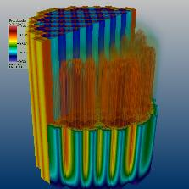
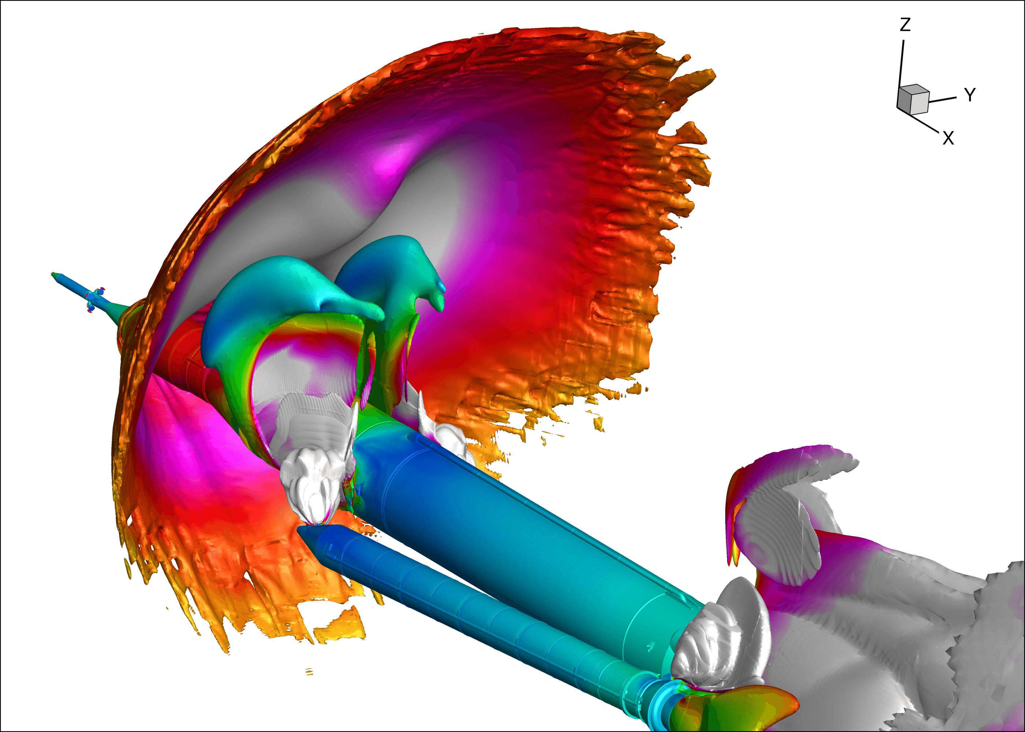
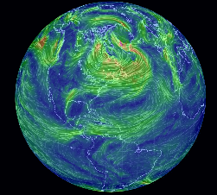
Research Computing Strategy
2
Research Computing
Introduction
In recent years computer-based simulation and modeling have been firmly established as integral parts of modern scientific research, alongside experiment, and theory.
Computation and high-performance computing (HPC) is now routinely used across numerous disciplines across KU.
To support the strategic vision of KU, and for KU to produce world class research, KU must invest in appropriate leading edge, stable and reliable technology.
Furthermore, access to these resources should be made available to all who require it.
Research Computing strategy and services need to be aligned with KU’s research focus areas, and strategic institutes and centres.
Notes:
RC manages and supports the centralized research computing facilities at Khalifa University.
RC works closely with colleagues in IT/ANKABUT to ensure delivery of consistent high-quality services that will address the research needs of KU faculty and broader research community.
The overall aim of RC is to provide leading edge, stable and reliable computing resources to Khalifa University researchers across all disciplines, and to provide the advice, training and skills necessary to make effective use of those resources.

Slide 3
Research Computing Strategy
3
Need for Research Computing at KU
RC conducted surveys in 2017, 2018 and 2021 to gather requirements and feedback from KU faculty, researchers and post-grads.
In all surveys, respondents expressed an overwhelming demand for more computational power, HPC, modern GPU’s, storage, workstations, virtual machines, and Linux support for shared servers.
In the most recent survey, 29% of respondents stated that they could not carry their research due to inadequate resources.
There were also a small number of requests for access to public cloud services, international supercomputing and a small number of requests for specialized computing platforms, e.g. FPGA’s.
The Research Computing Committee has also stated that computational resources available at KU are inadequate to meet the research requirements of KU.

Slide 4
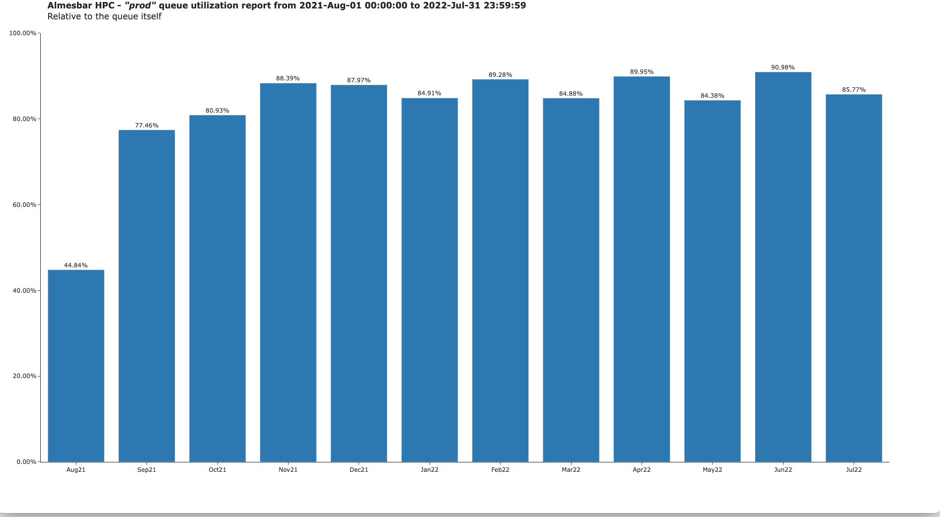
Research Computing Strategy
4

Slide 5
Research Computing Strategy
5
Interaction of RC and Ankabut
HPC System requirements
HPC System Administration
HPC Storage
Application profiling and optimization
Performance evaluation
HPC application support
Code porting and parallelization
GPU programming
Bespoke solutions and assessment
Specialist training
Outreach and user engagement
Grant proposal assistance and review
Linux VM Sysadmin
VM Management
2nd line support
Research
Computing
Core technology capability
Hardware hosting and maintenance
Storage and Backup
Networking and Security
Other RC infrastructure
Architecture
Identity and Access management
Academic software usage monitoring
1st line support
Service Desk
End user computing
Ankabut

Slide 6
Research Computing Strategy
6
RC Current Services
KU HPC capability and requirements are steadily growing
Current KU capabilities lag behind other institutes, causing delays to research outcomes.
Aim to increase HPC provision to 30,000 CPU cores, and 48 GPU cards by 2024.
Require regular investment to stay up to date and competitive
Will include specific investments to support strategic projects, such as RIC-2D.

Slide 7
Research Computing Strategy
7
HPC plan 2021 - 2025
 | 2021 | 2022 | 2023 | 2024 | 2025
HPC provision | 88 CPU nodes ( 4,576 CPU cores) 3 GPU nodes (12 GPU Nvidia V100 cards, 156 CPU cores) Total 401.9 TFLOPS | 124 CPU nodes (6,136 CPU cores) 7 GPU nodes (20 GPU Nvidia V100 cards, 260 CPU cores) Total 597.8 TFLOPS | 190 CPU nodes (9,568 CPU cores) 7 GPU nodes Total 828.4 TFLOPS | New cluster with 30,000 cores – 1,176.6 TFLOPS 190 CPU nodes 7 GPU nodes Total 2,005 TFLOPS | 30,000 core cluster 190 CPU nodes 7 GPU nodes Total 2,005 TFLOPS
Action | Currently in process purchasing hardware to expand HPC by: 36 CPU nodes (1,560 CPU cores) 4 GPU nodes (8 GPU Nvidia V100 cards, 104 CPU cores) 400 TB /home storge | Expand HPC by: 66 CPU nodes (3,432 CPU Cores). This includes dedicated nodes for RIC-2d and ENTC 200 TB /home storage Depending on requirements may invest in more GPU nodes instead of CPU nodes. | Plan and procure major upgrade to HPC facilities, due to new strategic projects. Procure by end of 2023 for operation in 2024. Operate HPC, gather evidence and data on usage and demands. | Operate two clusters side by side. Extend existing support for HPC hardware to 2025. May require changes to Datacenter as regards cooling and power provision to racks. This will incur a cost | Upgrade HPC based on requirements and demands.
CAPEX | 3.5M AED |  | 22M AED (estimated) |  | TBD
OPEX |  | 6M AED (estimated) | 3M AED | 3.2M AED | 3.2M AED (estimated)

Slide 8
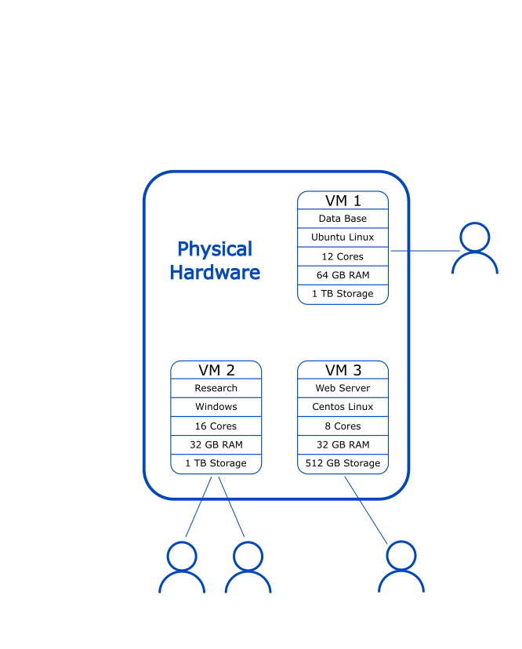
Research Computing Strategy
8
RC Current Services
Private Cloud/VM services
Hardware purchased was used to expand cloud services provided by Ankabut.
Ankabut is managing hardware, infrastructure and cloud services layer.
Research Computing is responsible for virtual machine management, configuration, system administration and application installation.
This simplifies management, security and data protection, provisioning, access to software and removes system administration burden from researchers.
In addition, will cut down on lengthy procurement lead times, as can act as an alternative to purchasing workstations, and shared servers for individual research groups.

Slide 9
Research Computing Strategy
9
RC Current Services
Support, Scientific Computing support and Consultation
Work in conjunction with researchers to design and implement bespoke computing resources to support research projects.
Support researchers by understanding their research computational needs and recommend suitable applications and other research computing resources available at the University.
Develop and maintain documentation and guidelines to assist users to make use of computational resources
Provide scientific computing support.
Evaluating, optimizing and deploying new software on the HPC clusters
Application profiling and performance evaluation
Develop and deliver specialized training courses.
Notes:
Assist researchers with grant proposals that have a strong High Performance Computing (HPC) component to describe the utilization of HPC resources in their research.
Ensure to resolve faculty and student computing resource issues and provide programming consultancy, code optimization and resolve users’ programming issues (based on Unix shell script, C/C++, Matlab, Python, MPI, OpenMP, CUDA).
Build, install, maintain and test scientific applications on the HPC clusters.
Develop awareness and training programs for students, faculty, and staff with regards to research computing techniques, services, and facilities, including HPC application training to help users parallelize, debug and optimize their applications.
Conduct regular trainings workshops and tutorials, as well as one-on-one training for new users.

Slide 10
Research Computing Strategy
10
RC Planned Services
Big Data Platform for health sciences research
In process of configuring dig data platform, and other computational resources, for the Research and Data Intelligence Support Center (RDISC).
The platform will provide services such as HADOOP, Spark, large scale storage, and management of health-related data.
Data Storage Services
Underlying all computational resources, should be robust and reliable storage services.
HPC and Private cloud include various types of storage, and these will be expanded periodically as demand grows. Please see appendices for details of expansion.
Working with Ankabut to build on existing services, and establish process, hardware and service to provide expandable, accessible and large scale tiered storage for research.

Slide 11
Appendix

Slide 12
Research Computing Strategy
12
RC Org structure

Slide 13
Research Computing Strategy
13
Research Computing Personnel
Current Staffing
Director: Sets direction and goals of team, budgeting, planning, strategy.
Senior HPC System Administrator: Day to day operation of HPC systems and back up Unix sysadmin.
Senior System Administrator -Unix: Day to day operation of VM Machines and backs up HPC system administrator. Support researchers using Linux.
Senior Specialist, scientific computing support: Day to day scientific support with focus on outreach and training.
Current Vacancies
RC infrastructure manager: This technical lead post is necessary to ensure that current and future research computing resources are designed and integrated correctly into the overall infrastructure of the university. Furthermore, it is necessary to ensure that research computing facilities keep up with the state of the art. Currently vacant.
Scientific computing support manager: Provides scientific computing support, consults with researchers, code porting. Needed to grow the understaffed Scientific Computing support function. Currently vacant

Slide 14
Research Computing Strategy
14
RC Governance
Research Computing Committee (RCC)
The RCC serves in an advisory capacity for the Research Computing department.
It is a forum to discuss and make recommendations regarding KU’s research computing requirements, strategies, allocation of resources, policies and standards.
Membership is comprised of 2 faculty representatives from each of the three colleges, an Ankabut representative and chaired by Director of Research Computing.
Research Computing User Group
User Group represents all users of HPC and Research Computing resources.
Meetings are chaired by a Faculty member.
It provides feedback on current performance and configuration of HPC and Research Computing resources, to inform decisions to be taken by the RCC
Notes:
Its responsibilities include:
Ensuring that research computing strategies and plans are aligned with KU’s research needs and objectives;
Evaluating KU research computing needs, challenges and options;
Advising and recommending direction and priorities for research computing investments, including research software, infrastructure and staff;
Members are nominated by the Deans and appointed by SVP of Research.

Slide 15
Research Computing Strategy
15
RC Objectives and KPIs
Objectives | KPI | Comment
Support computationally based research | Research projects supported on RC resources Users supported on RC resources Publications supported by RC resources | Need to collect baseline data on publications. Reliant on faculty/researcher acknowledging use of RC resources
Ensure that services and resources meet researcher requirements | Distribution and analysis of annual Survey | Have baseline data, need to improve on response rates to survey, and on percentage of researchers reporting adequate provision of resources.
Optimize utilization of RC resources | Utilization rate of resources | The rate needs to be high, but also need to stay ahead of demand.
Maximize availability of resources | Uptime rates | Minimize unplanned downtime
Deliver high quality training | Size of training portfolio Number of courses delivered Number of users trained
User Base engagement | Number of User Group meetings Number of outreach events

Slide 16
Research Computing Strategy
16
Research Computing mapping to new Strategy R&D Themes and Topics
Research Area | Primary Centers | Sub-Area | Research Computing
Energy | APEC, ENTC, RICH, SBRC/Air-CRAFT | Solar energy | HPC Cluster Private Cloud/VM Services Dedicated HPC nodes for ENTEC(in process) Scientific Computing support
 |  | Nuclear energy
 |  | Electrical power transmission and distribution
 |  | Energy storage
 |  | Energy efficient cities and buildings
 |  | Hydrogen and its derivatives
 |  | CO2 capture, utilization and storage
 |  | Sustainable fuels (low-carbon oil and gas)
Water & Environment | CMAT, ENGEOS/ EARTHCARE | Desalination | HPC Cluster Private Cloud/VM Services Scientific Computing Support
 |  | Waste treatment and utilization
 |  | Environmental remote sensing
 |  | Ocean and coastal ecology and environment
Health | BTC, HEIC, RDISC | Omics (proteomics, genomics, metabolomics) | HPC Cluster Private Cloud/VM Services Big Data Platform Object Storage Teaching and Research Lab Sysadmin for Bioinformatics server Scientific Computing support
 |  | Medical technology (bio-robotics and medical devices)
 |  | Therapeutics (pharmacology, clinical toxicology, virology and tissue culture)
 |  | Analytics (epidemiology, biostatistics and modeling, bioinformatics, bio-signal processing)
 |  | Management and operations
Space | KUSTIC, SPSC, ENGEOS/ EARTHCARE | Space telecommunications, access and exploration (technology development and science applications) | HPC Cluster Private Cloud/VM Services Scientific Computing support
 |  | Earth observation

Slide 17
Research Computing Strategy
17
Research Computing mapping to new Strategy R&D Themes and Topics
Research Area | Centers | Sub-Area | Research Computing
Advanced Material & Manufacturing | ARIC, AMCC, CeCaS, RIC-2D | Computational materials engineering | HPC Cluster Private Cloud/VM Services Dedicated HPC nodes for RIC-2D (in process) Scientific Computing support
 |  | Composites
 |  | Enhanced materials systems (nanomaterials and nanocomposites, multifunctional materials, smart materials, metamaterials)
 |  | Catalysis
 |  | Additive manufacturing
 |  | Manufacturing automation
Intelligent & Secure Digital Systems | KUCARS, SOCL, C2PS, EBTIC | Autonomous systems (aerial, ground and marine) | HPC Cluster Private Cloud/VM Services Sysadmin support for SoC Scientific Computing support
 |  | Machine learning
 |  | Computer vision, image and video analysis and processing
 |  | Data Science
 |  | Secure systems and networks (cyber security and blockchain)
 |  | Next Generation Networks (NGNs) and NGN-enabled ICT applications and services
 |  | System-on-Chip (SoC) technology
 |  | Sensors
Emerging Topics & Fundamental Science |  |  | HPC Cluster Private Cloud/VM Services Scientific Computing support

Slide 18
Research Computing Strategy
18
KU Academic Departments and Research Computing
College | Academic Department | Research Computing
College of Medicine and Health Sciences |  | Yes
College of Engineering | Aerospace Engineering | Yes
 | Biomedical Engineering | Yes
 | Chemical Engineering | Yes
 | Civil Infrastructure and Environmental Engineering | Yes
 | Electrical Engineering and Computer Science | Yes
 | Industrial and Systems Engineering | No
 | Mechanical Engineering | Yes
 | Nuclear Engineering | Yes
 | Petroleum Engineering | Yes

Slide 19
Research Computing Strategy
19
KU Academic Departments and Research Computing
College | Academic Department | Research Computing
College of Arts and Sciences | Biology | Yes
 | Chemistry | Yes
 | Earth Sciences | Yes
 | English | No
 | Humanities and Social Sciences | No
 | Mathematics | Yes
 | Physics | Yes
 | Preparatory Program | No
 | Pre-Medicine Bridge Program | Yes

Slide 20
Research Computing Strategy
20
Data Storage Gaps and challenges
Data Management policies: There is a need for clear and comprehensive data management polices for KU.
Large scale research data storage: There is a need for processes, tools and infrastructure for large scale storage of research data, in compliance with data management policies of KU.
General purpose storage: A need for general purpose storage accessible from faculty/researcher laptop and workstations.
Funding from research projects: There is a need for a mechanism to use project funds to purchase storage, via CAPEX, but also via OPEX
Purchasing IT services: Current rules mean that KU is unable to transfer funds to Ankabut or pay them for IT services. This means that RC and KU cannot leverage existing IT infrastructure, and this means that KU will continually need to invest large amounts of CAPEX to fund services.

Slide 21
Research Computing Strategy
21
RC Current Services - Almesbar HPC Cluster
Number of nodes |  | Cores per node |  | Network interconnection
88 CPU nodes | 2x Intel Xeon Gold 6230R 26-Core 2.1GHz (Cascade lake) (Q1‘20) | 52 |  | Infiniband HDR and Infiniband EDR
 |  | Memory per node |  | Storage
3 GPU nodes | 2x Intel Xeon Gold 6230R 26-Core 2.1GHz(Cascade lake) (Q1’20) | CPU nodes | 384 GB | 300 TB home | NFSv4
 | 4x NVidia V100 | GPU nodes | 640 GB + 128 GB (GPU) | 947 TB scratch | Parallel file system (Lustre)
Total CPU cores | Theoretical peak of performance
4,732 | 401.9 TFLOPS
Total GPU cores | Estimated peak of performance
61,440 | 321.52 TFLOPS
Total memory
35.25 TB
HPC cluster to be expanded periodically to scale with demand. See Appendix for details.
Cluster was designed to be quickly expandable, with ability to increase by 40% with minimal disruption.

Slide 22
Research Computing Strategy
22
Private Cloud/VM plan 2021 - 2025
 | 2021 | 2022 | 2023 | 2024 | 2025
Private cloud provision | Formerly Hosted at Masdar : 474 vCPUs 228 TB of storage | 1130 vCPUs 400 TB of storage | 1356 vCPUs 520 TB of storage | 1628 vCPUs 680 TB of storage | 1954 vCPUs 884 TB of storage
Action | This workload has been migrated and the hardware decommissioned. It is now hosted on temporary resources provided by Ankabut. Currently in process of procuring private cloud infrastructure. Resources being purchased: 1130 vCPUs 400 Tb of storage Sizing considers current workload, resources to migrate some research groups from aging workstations and to allow room for growth. | Expand private cloud vCPU provision by 20% and data storage by 30 % to allow for growing demand. Develop processes and criteria for resource allocation Liaise with colleagues in Research Department and Ankabut to lobby KU Finance to create mechanism to use funds from research projects to purchase IT services from Ankabut, or to expand existing services. Form partnerships with Public Cloud providers to accommodate non-standard computational requirements, e.g. ASIC, FPGAs .., and test beds, and to complement KU offerings. Use OPEX to purchase public cloud services | Expand private cloud provision by 20% and data storage by 30% allow for growing demand. Evaluate any services utilized on public cloud, to see if services should be provided at KU. Continue to work with Public Cloud providers to accommodate non-standard requirements. | Expand private cloud provision by 20% and data storage by 30%. Evaluate any services utilized on public cloud, to see if services should be provided at KU. Continue to work with Public Cloud providers Extend support for private cloud hardware to 2025 | Evaluate available technology. Gather KU requirements. Decide course of action; carry on expanding services or procure new services.
CAPEX | 3M AED | 700K AED (estimated) | 700K AED (estimated) | 700K (estimated) | TBD
OPEX |  | 200K AED (estimated) | 200K AED (estimated) | 825K AED (estimated) | 200K AED

Slide 23
Research Computing Strategy
23
Data Storage plan 2021 - 2025
 | 2021 | 2022 | 2023 | 2024 | 2025
Storage provision | 300 TB HPC /home storage 974 TB HPC /scratch storage 228 TB of private cloud storage | 700TB HPC /home storage 974 TB HPC /scratch storage 400 TB of private cloud storage | 900TB HPC /home storage 974 TB HPC /scratch storage 520 TB of private cloud storage | 900TB HPC /home storage 974 TB HPC /scratch storage 680 TB of private cloud storage | 900TB HPC /home storage 974 TB HPC /scratch storage 884 TB of private cloud storage
Action | Migration of data at Masdar and SAN campuses to KU Campus resources | Form working group to develop comprehensive Data Management Policies for KU Liaise with colleagues in Research Department and Ankabut to lobby KU Finance to create mechanism to use funds from research projects to purchase IT services from Ankabut, or to expand existing services. | With Data Management Policies in place, gather requirements for new storage services. Design new storage services and request budget. | Liaise with Ankabut to procure and install new storage services. | Evaluate service and gather data.
CAPEX |  |  |  | TBD
OPEX |  |  |  | TBD

